Slide 1
Exploit SUDO Security Policy Bypass Vulnerability in LINUX
Notes:
Hello Everyone!
In this exercise, titled 'Exploit SUDO Security Policy Bypass Vulnerability in LINUX', you'll learn about a critical security issue affecting LINUX systems —specifically, a vulnerability in the sudo utility that allows attackers to bypass security policies.
sudo is a vital tool in Linux, granting users elevated privileges to execute commands, crucial for system administration. This presentation will focus on understanding and exploiting a vulnerability that affects certain versions of sudo on LINUX systems. This flaw, if exploited, can enable attackers to escalate their privileges and gain unauthorized root access, compromising system security.

Slide 2
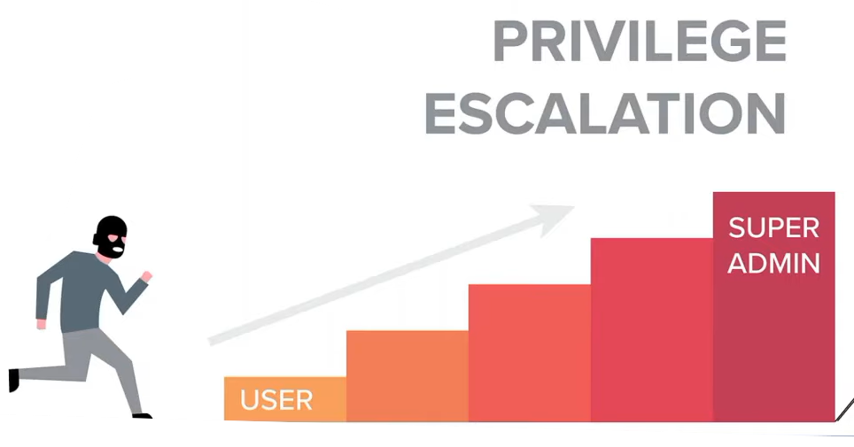
Problem Statement: Exploit SUDO Security Policy Bypass Vulnerability in LINUX
Technique: Linux Privilege Escalation Technique
CVE-2023-22809: sudoedit Privilege Escalation
Key Details:
Vulnerability Type: SUDO Privilege Escalation
Severity: Critical
Attack Vector: Local
Complexity: Low
Privileges Required: Low(User with sudoedit permissions on at least one non-sensitive file.)
User Interaction: None
Impact: High on Confidentiality, Integrity, and Availability
Notes:
Now, let's focus on a specific instance of this vulnerability: CVE-2023-22809, which involves privilege escalation through the sudoedit command. This vulnerability affects sudo versions from 1.8.0 to 1.9.12p1, enabling local users to bypass security policies and manipulate files with elevated privileges.
Understanding CVE-2023-22809 is crucial as it highlights a significant risk where attackers can gain unauthorized access and potentially control the entire system.

Slide 3
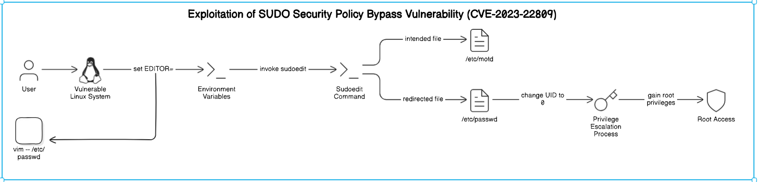
System Architecture:
Notes:
Now, let's visually explore how the CVE-2023-22809 vulnerability can be exploited on a vulnerable Linux system.
This system architecture diagram illustrates the exploitation process of the SUDO Security Policy Bypass Vulnerability (CVE-2023-22809) on a vulnerable Linux system. The diagram visually depicts the interaction between the user and the system, highlighting how the EDITOR environment variable is manipulated.
The diagram demonstrates how the sudoedit command, intended for editing the /etc/motd file, is redirected to modify the critical /etc/passwd file.
By manipulating the EDITOR environment variable, attackers reroute the sudoedit command's functionality from innocuous file editing to altering system files.
Specifically, the user exploits this redirection to modify the /etc/passwd file, changing their User ID (UID) to 0, which grants unauthorized root access.
This visual representation clarifies the technical process of exploiting CVE-2023-22809, highlighting the critical role of environment variable manipulation in privilege escalation.

Slide 4
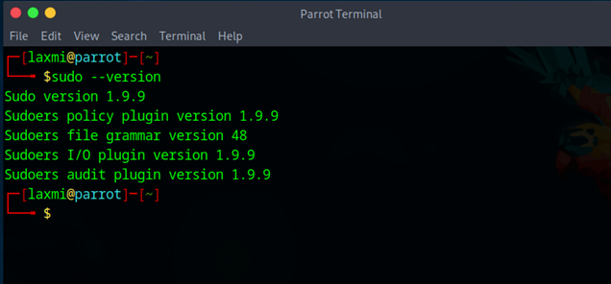
Performing Sudoedit Privilege Escalation
Step1: Check the Sudo Version:
Notes:
Now, we’ll explore on the practical steps involved in performing sudoedit privilege escalation.
Step 1 focuses on verifying the version of sudo installed on your Linux system to determine if it is vulnerable to the sudoedit privilege escalation exploit (CVE-2023-22809).
Execute sudo --version command in the terminal.
This command retrieves and displays the version information of the sudo utility currently installed on the system.
Review the output to identify the version number of sudo.
Versions ranging from 1.8.0 to 1.9.12p1 are susceptible to the vulnerability.
Verifying the sudo version is an essential initial step in securing Linux systems against CVE-2023-22809 exploitation.

Slide 5
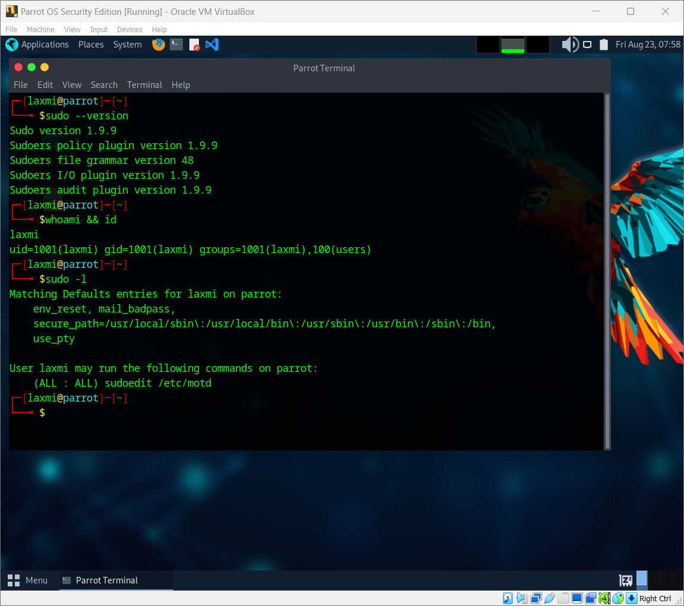
Step2: Checking the User and User ID
Step3: Checking for User Permissions
Notes:
Step 2 involves verifying the identity and privileges of the current user on the Linux system, using whoami and id commands.
Whoami displays the current logged-in username and id Shows the user ID (UID) of the current user. These commands provides straightforward information about the identity of the user currently interacting with the system.
Then Step 3 involves using the sudo -l command to list the sudo permissions granted to the current user on the Linux system, crucial for determining vulnerability exploitation.
If the sudo version is within the vulnerable range and the user has sudoedit permissions as per the sudoers configuration, the system is at risk, and the user might be able to exploit the vulnerability.

Slide 6
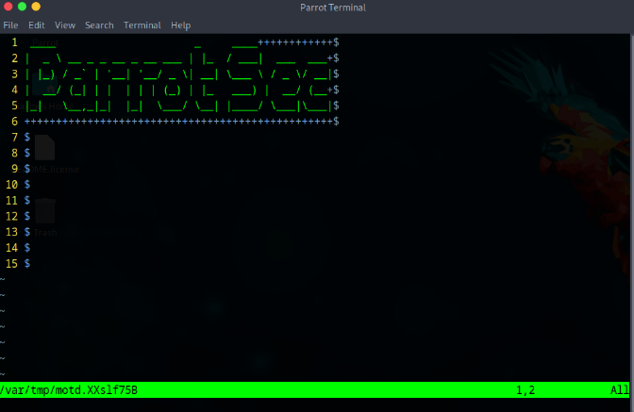

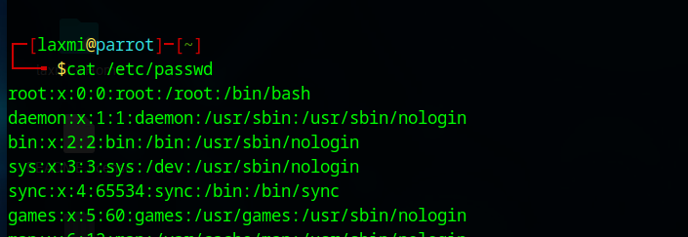
Step4: Opening and Checking the File Permitted to Edit
Step5: Viewing the /etc/passwd File
Notes:
Now, moving to Step 4 we use the sudoedit /etc/motd command to attempt editing the /etc/motd file with elevated privileges on the Linux system.
Conducting this step helps in assessing the extent of access granted to privileged users.
Step 5 involves using the cat /etc/passwd command to output the contents of the /etc/passwd file on the Linux system.
Viewing /etc/passwd confirms whether the user possesses permissions to read sensitive system data, highlighting potential security weaknesses.

Slide 7
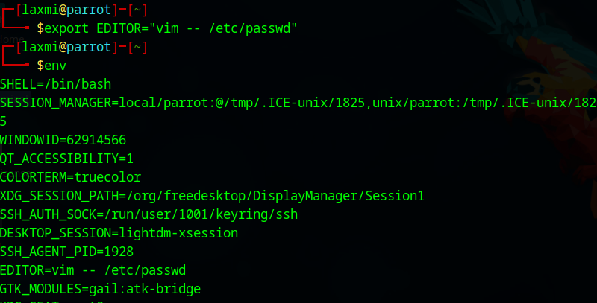
Step6: Setting the EDITOR Environment Variable
Step7: Checking the Environment Variables
Notes:
Now in Step 6, involves setting the EDITOR environment variable using the command export EDITOR="vim -- /etc/passwd" on the Linux system. This command executes the export command to configure the EDITOR environment variable. By setting EDITOR to vim -- /etc/passwd, it directs sudoedit to open the Vim editor specifically with the /etc/passwd file as an argument whenever sudoedit is invoked. This setup creates a scenario where the sudoedit command, if exploited by an attacker, unintentionally opens the critical system file /etc/passwd in the Vim editor, potentially enabling unauthorized access and privilege escalation.
Step 7 involves executing the env command, which lists all environment variables currently active in the terminal session. This step verifies whether the EDITOR environment variable has been correctly set to vim -- /etc/passwd.

Slide 8
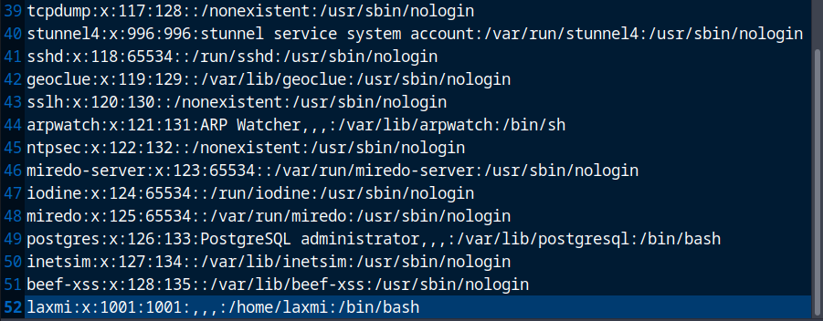
Step8: Using Sudoedit with Modified EDITOR Variable
Notes:
The step8 Executes the sudoedit command with the intention to edit the /etc/motd file. However, due to the previously modified EDITOR environment variable (vim -- /etc/passwd), sudoedit will unintentionally open and potentially allow modification of the /etc/passwd file.

Slide 9
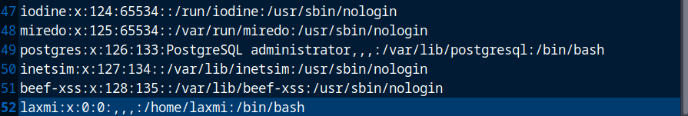
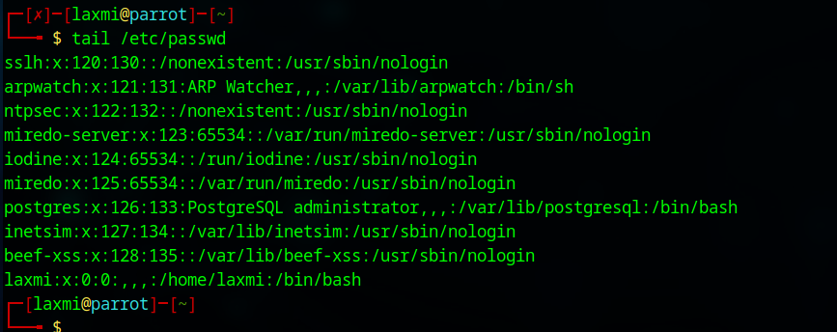
Step9: Changing the Current User's ID to 0
Step10: Verifying the Change in User ID
Notes:
The step9 involves editing the /etc/passwd file to change the current user's UID to 0, emulating the root user's privileges.
Accessing and altering /etc/passwd allows the user to make administrative changes that grant powerful control over the system.
Step 10 Executes the cat command with the argument /etc/passwd, displaying the contents of this system file which stores user account information, including user IDs (UIDs).
This step confirms whether the previous modification, changing the current user's UID to 0 (root), was successful.

Slide 10
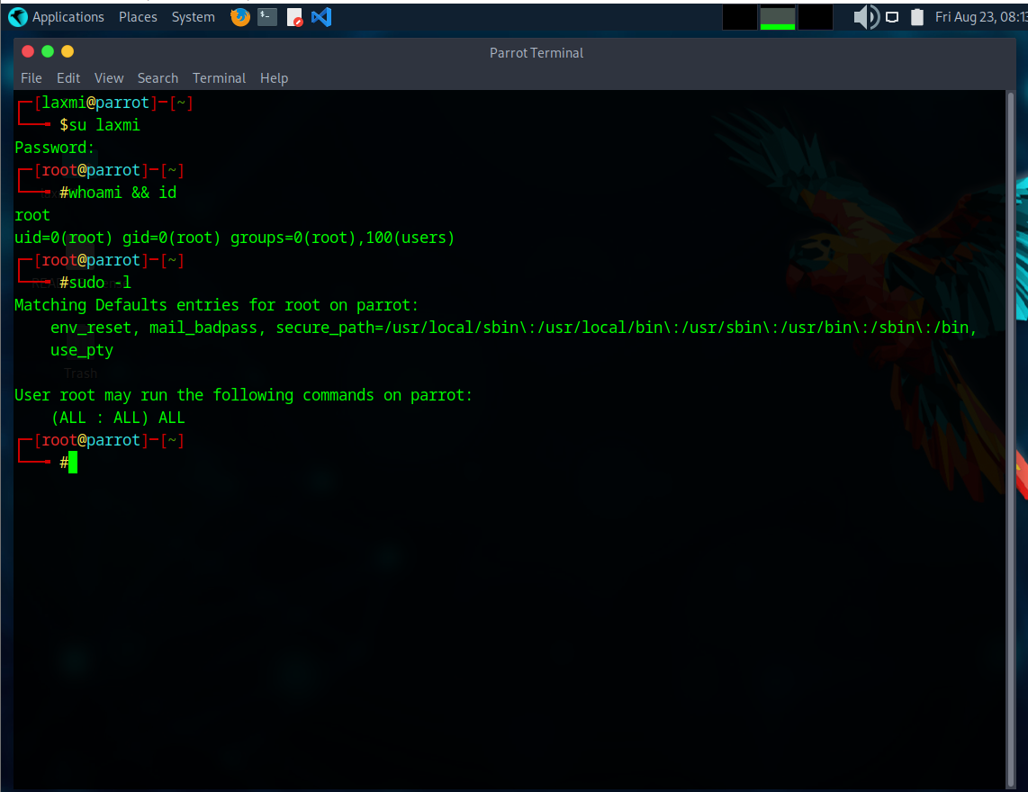
Step11: Switching to Another User
Step12: Confirming the User Switch and Privileges
Notes:
Step 11 involves using the su username command on the Linux system to switch from the current user account to another user's account.
Here specifically switches to the user whose UID was changed to 0, effectively granting root privileges and full control over the system.
Finally, Step 12 involves using the whoami && id command on the Linux system to verify the successful switch to the root user and confirm the acquisition of root privileges.
And this step validates that the attacker has achieved the desired level of control over the system, allowing them to perform administrative tasks and execute commands with higher authority.
Next, we will discuss mitigation strategies.

Slide 11

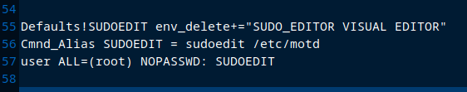
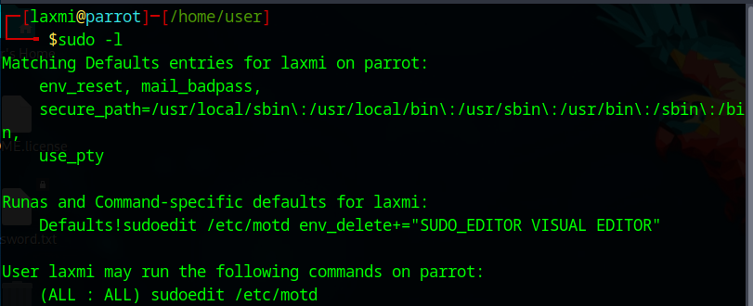
PREVENTION FROM THE ATTACK:
Add specific environment variables to the denial list using the env_delete directive in /etc/sudoers.
Notes:
To prevent the exploitation of the sudo security policy bypass vulnerability (CVE-2023-22809), we will add specific environment variables to the denial list using the env_delete directive in /etc/sudoers. This will ensure that potentially dangerous environment variables are not passed to sudoedit.
Step1: Use the visudo Command to Safely Edit the sudoers File: This command ensures that the sudoers file is edited safely and prevents syntax errors.
Step2: Within the visudo Editor, Add the above mentioned Lines to the File:
Adding Environment Variable Restrictions:
Defaults!SUDOEDIT env_delete+="SUDO_EDITOR VISUAL EDITOR": This line ensures that the specified environment variables (SUDO_EDITOR, VISUAL, and EDITOR) are deleted when using sudoedit. This prevents the exploitation of these variables to execute arbitrary commands.
Cmnd_Alias SUDOEDIT = sudoedit /etc/motd: This line creates a command alias SUDOEDIT that allows editing of the /etc/motd file.
user ALL=(root) NOPASSWD: SUDOEDIT: This line grants the specified user permission to edit the /etc/motd file as the root user without requiring a password.
Note:
Replace user with the actual username you want to grant the permissions to.
Replace /etc/motd with the file you want to allow the user to edit.
3. Verify the New Rule: After editing the sudoers file, you can verify the applied rules by listing the sudo permissions.

Slide 12

B. Update SUDO to the Latest Version.
Notes:
And also ensure SUDO is updated regularly to the latest version for receiving security patches against vulnerabilities.
Restricting environment variables and updating SUDO to the latest version effectively protect against CVE-2023-22809, improving Linux system security and stability.

Slide 13
Thank You
Notes:
Thank you for your attention and interest in this presentation.

